Slide 1
Episode 4: Leveraging AI Driven Smart Labeling in Exterro Review
PRESENTED BY:
James Blackburn & Karl Bridgers
Notes:
Speaker: Sam
Controls: James / Karl
Practice WC = Karl, James, and Sam
Play Button = people can see your screen, you’ve opened the lobby
Start Broadcast = people can hear you and recording starting
Duration: 1 min
SAM INTRO:
Hello everyone, my name is Samantha Nguyen, Client Marketing Manager here at Exterro, and I welcome you to today’s customer exclusive workshop training series - Episode 4: leveraging AI driven smart labeling in Exterro Review.
We’ll get started with the workshop in just a minute, but first a few brief reminders:
All lines have been muted to reduce background noise
We do encourage you to submit questions at any time through your webinar control panel and we will answer those at the very end.
This webcast will be recorded, and the recording along with the slides will be posted to Exterro’s customer exclusive resource archive, which we will send you a link to later today.
Lastly, a brief survey will pop up on your screen after the webcast closes, and we would greatly appreciate your participation in that survey.
With that, we are now ready to get into today’s presentation and meet your trainers! I will not hand that off to James and Karl.

Slide 2
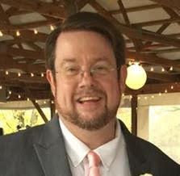
Today’s Trainers
James Blackburn
Karl Bridgers
Senior Instructor at Exterro
Senior Instructor at Exterro
Notes:
Speaker: James and Karl
Controls: James / Karl
Duration: 1- 2 mins

Slide 3
Smart Labeling in Exterro Review
Notes:
Speaker: James and Karl
Controls: James / Karl
Duration: 1- 2 mins

Slide 4
The Importance of Smart Labeling
Identify relevant documents faster
Save time during review
Increase accuracy, improve efficiency, and accelerate technology assisted review
Notes:
Speaker: James and Karl
Controls: James / Karl
Duration: 1- 2 mins

Slide 5
DEMO
Notes:
Speaker: James and Karl
Controls: James / Karl
Duration: 15 minutes

Slide 6
Best Practices + Tips
Know what you want
Have a plan
Configure your coding pane properly
Notes:
Speaker: James and Karl
Controls: James / Karl
Duration: 2 minutes

Slide 7
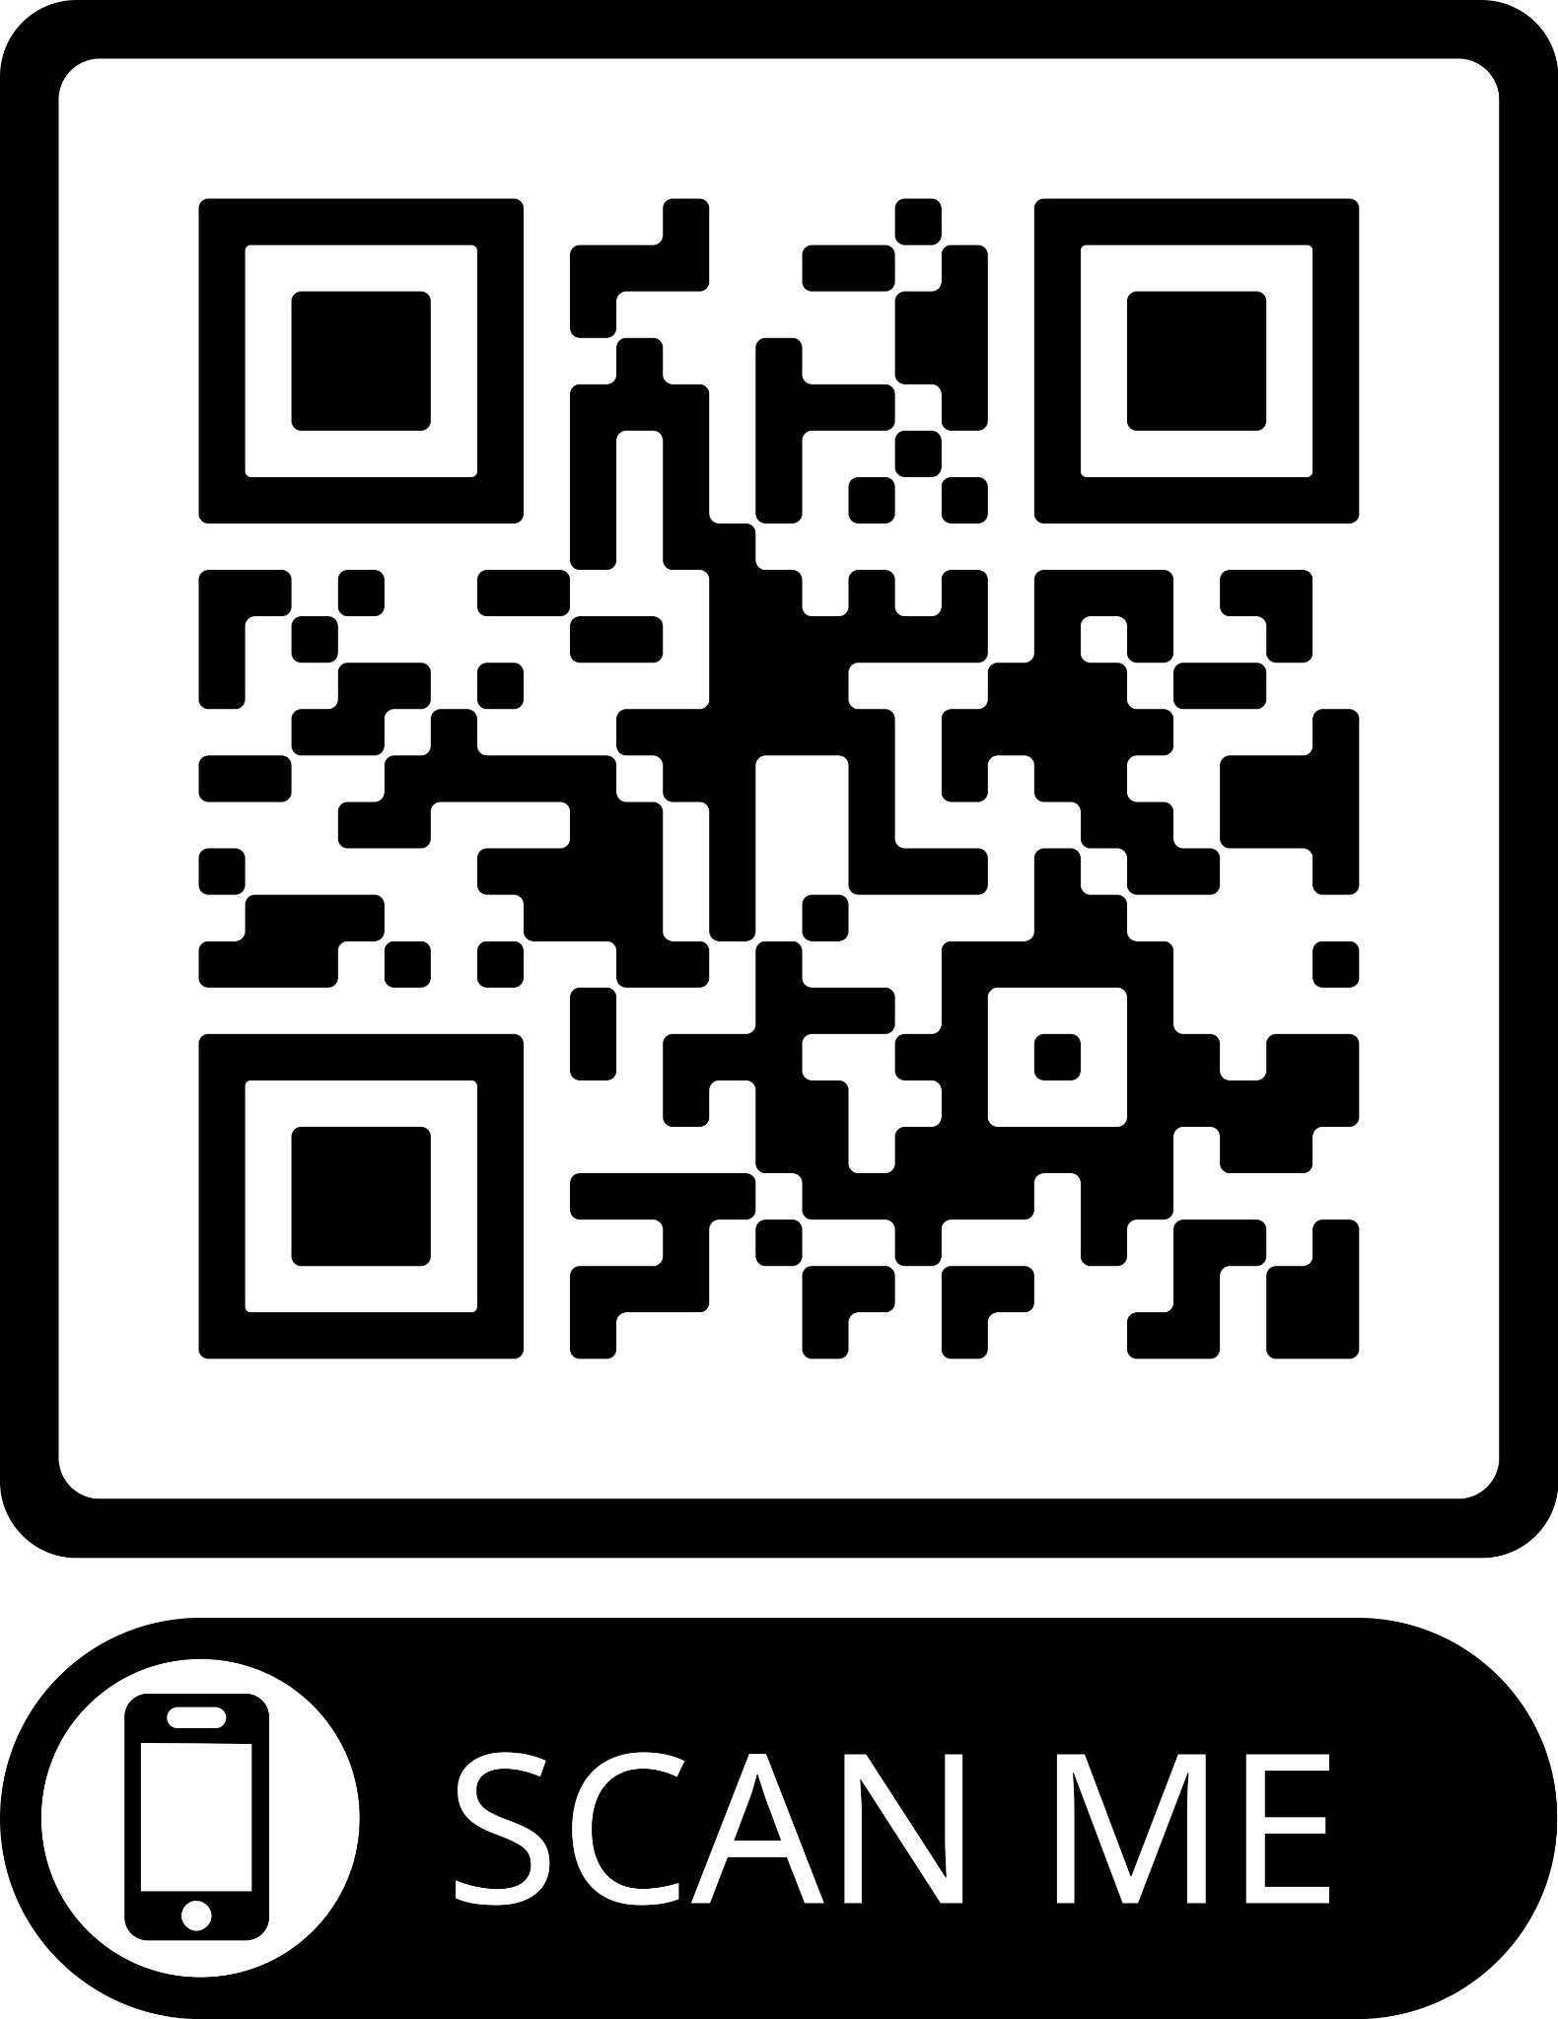
Meeting Your Training Needs
PUBLIC TRAINING:
The Exterro Review Core course provides the essential tools needed to perform a basic document review—matter navigation, searching, coding/tagging, and redacting.
Next training:
(LIVE ONLINE) Tuesday, August 22nd at 9am to 4pm CST
Notes:
Speaker: James and Karl
Controls: James / Karl
Duration: 1 minute

Slide 8
Meeting Your Training Needs
CUSTOM TRAINING
Need training specific to your workflow?
Exterro Training can create custom courses to meet your training needs–live online or in person.
Notes:
Speaker: James and Karl
Controls: James / Karl
Duration: 1 min

Slide 9
Meeting Your Training Needs
ON-DEMAND VIDEO RECORDINGS
Through Exterro Training’s LMS (Learning Management System), meet your training needs via video-on-demand (VOD), and watch anywhere, anytime on computer, tablet, or smartphone.
Exterro Training also offers Panoramas, a custom LMS for your organization. Set up a panorama to manage your team’s training needs.
Notes:
Speaker: James and Karl
Controls: James / Karl
Duration: 1 minute

Slide 10
Questions for the Trainers
James Blackburn
Karl Bridgers
Senior Instructor at Exterro
Senior Instructor at Exterro
Notes:
Speaker: James and Karl
Controls: James / Karl
Duration: 4 -5 mins

Slide 11
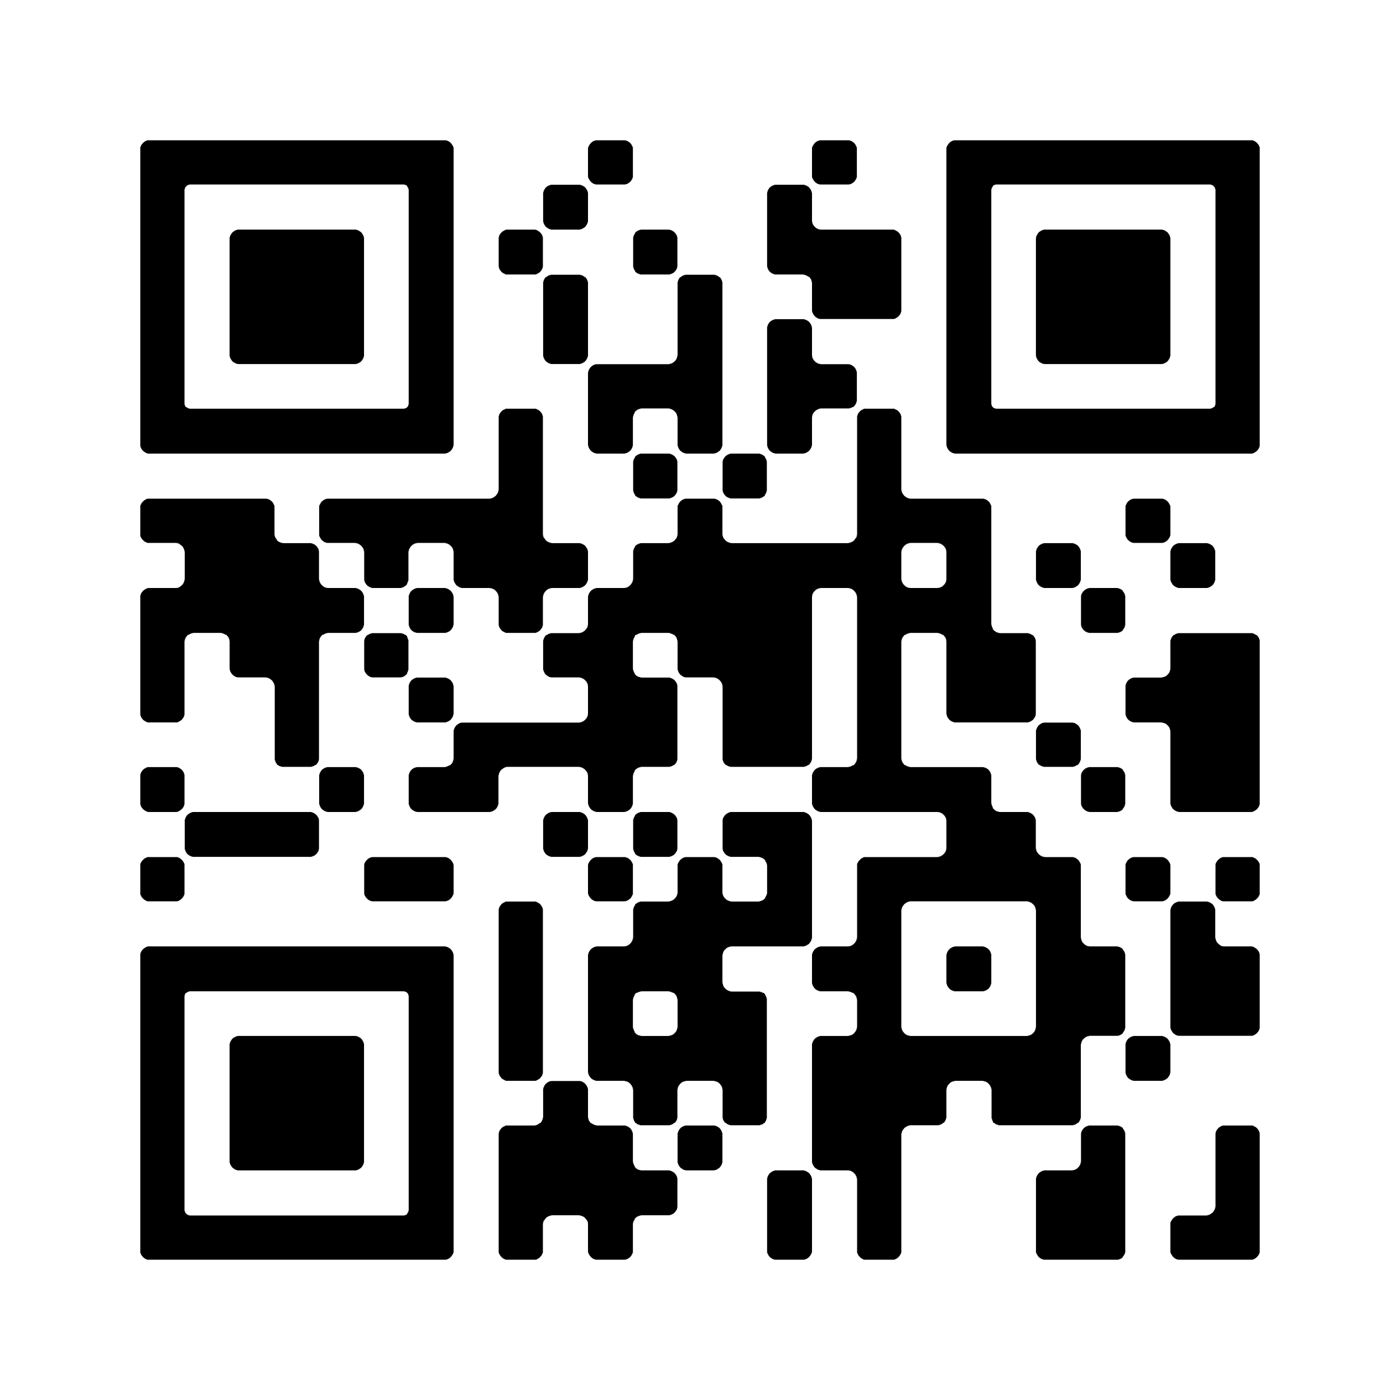
Big and BETTER than ever!
The Roosevelt Hotel New Orleans
Sept 19 - Certifications - Certified FTK 8.0 Reviewer; Certified Exterro Reviewer (Corporate Focused)
Sept 20-21 - General and User Conference
10 - 14 CLE expected
First 100 registrants will received a FREE rocketbook!
SEPT. 19-21, 2023
ADVANCED PRICE RATE UNTIL JULY 31ST
$
895
Notes:
Speaker: Samantha
Controls: James
Duration: 1 min
Exterro XChange is more than a conference. It's a vibrant community of professionals exchanging ideas, making connections, acquiring new skills, and exploring the complex connections between privacy, e-discovery, cybersecurity compliance, and digital forensics. I like to invite you all to join us and other Exterro users, experts, partners, and thought leaders together in person for three days of learning, networking, and fun in New Orleans!
Right now, we are currently having our early bird pricing. Please use the QR code on the screen to register today!

Slide 12
Thank You!
For more information on anything from today’s presentation and questions about Exterro Training, please contact…
James Blackburn james.blackburn@exterro.com
Karl Bridgers karl.bridgers@exterro.com
FOR MORE INFORMATION VISIT:
www.exterro.com
Notes:
Speaker: Samantha
Controls: James / Karl
Duration: 30 seconds
Thank you for attending today’s workshop training. If you any questions from today’s session, please contact James or Karl via email on the screen.
We look forward to seeing you in our next workshop training!

